Slide 1
BCOG 100
The Evolution of Neurons
Lecture 2: The Evolution of Neurons

Slide 2
Reading Check 4-2
Password: action
Question: What does ”all or none” mean with regard to neurons, and why is it useful for neurons to be that way?

Slide 3
The Evolution of Neurons
Today’s Outline
Oxygen → energy revolution
Eukaryotes & endosymbiosis
Multicellularity & specialization
Animals vs. plants vs. fungi
Why animals needed neurons
What neurons are & how they work
Notes:
Today we’re picking up right where we left off. Last time, we saw how oxygen was both poison and opportunity.
For organisms that could survive it, oxygen unlocked a massive energy advantage —
about 15 times more ATP from the same food.
So the big question for today is: what did life do with all that new energy?
We’re going to follow the story in a few steps:
First, how oxygen powered the rise of more complex cells called eukaryotes.
Then, how multicellularity created new possibilities.
We’ll compare three big strategies: plants, fungi, and animals.
And we’ll see why only animals needed neurons.
Finally, we’ll look closely at neurons themselves — what they are, how they work, and why they matter.
By the end of today, you’ll see how evolution invented the neuron — the building block of all brains.

Slide 4
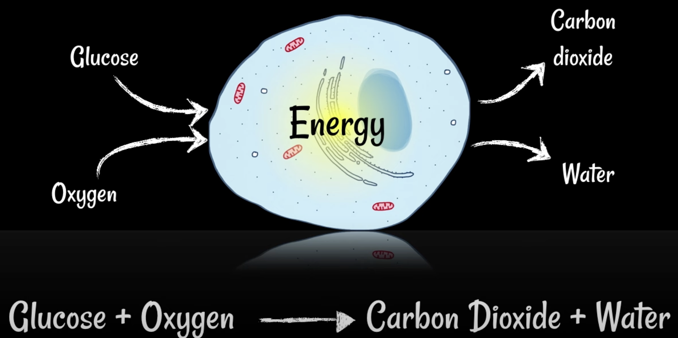
The Evolution of Neurons
After Oxygen: A New Energy World
Respiration with O₂ = ~15× more ATP
Energy surplus → new possibilities:
bigger cells
faster growth and replication
more complex internal machinery
Notes:
Once oxygen was in the environment, some cells evolved ways to use it as the final electron acceptor in respiration.
This was a game-changer.
Using oxygen allowed cells to squeeze out about 15 times more ATP from the same food compared to earlier anaerobic systems.
Imagine upgrading from a hand-crank flashlight to a high-capacity battery — suddenly you can power much more.
What did this energy surplus mean? It allowed cells to:
Grow larger without starving,
Replicate faster,
Support more complex internal machinery.
This surplus of energy was the foundation for all later biological complexity.
Without it, neurons and brains would never have been possible —
they are simply too expensive to run on low-energy chemistry.

Slide 5
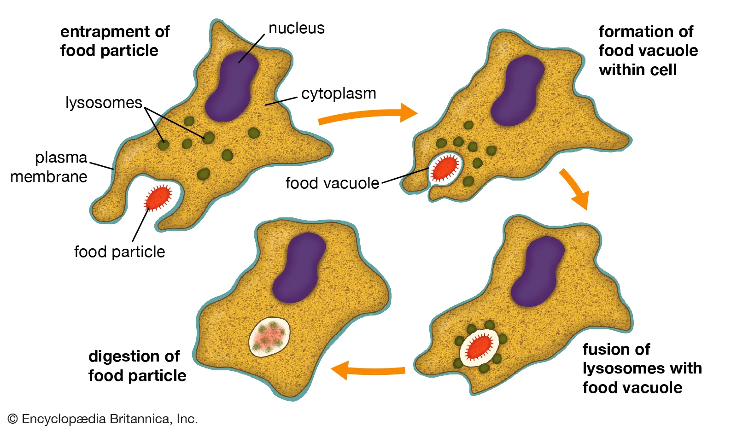
The Evolution of Neurons
Predator–Prey Arms Race
More energy → new lifestyles
Hunting emerges
Predators vs. prey = speed & coordination matter
Notes:
With all this extra energy, cells could do more than just sit and absorb nutrients from their surroundings.
A completely new lifestyle appeared: hunting.
Some organisms became predators, engulfing and digesting other cells.
Others became prey, evolving defenses to avoid being eaten. This set off an evolutionary arms race.
In this new world, speed and coordination suddenly mattered.
Predators needed to sense, move, and react quickly.
Prey needed to escape, hide, or defend themselves.
This arms race is what eventually drove the evolution of more complex cells, and multicellular organisms.
and — as we’ll see — neurons.
Neurons are, in many ways, the solution evolution came up with for the challenges of predation.

Slide 6
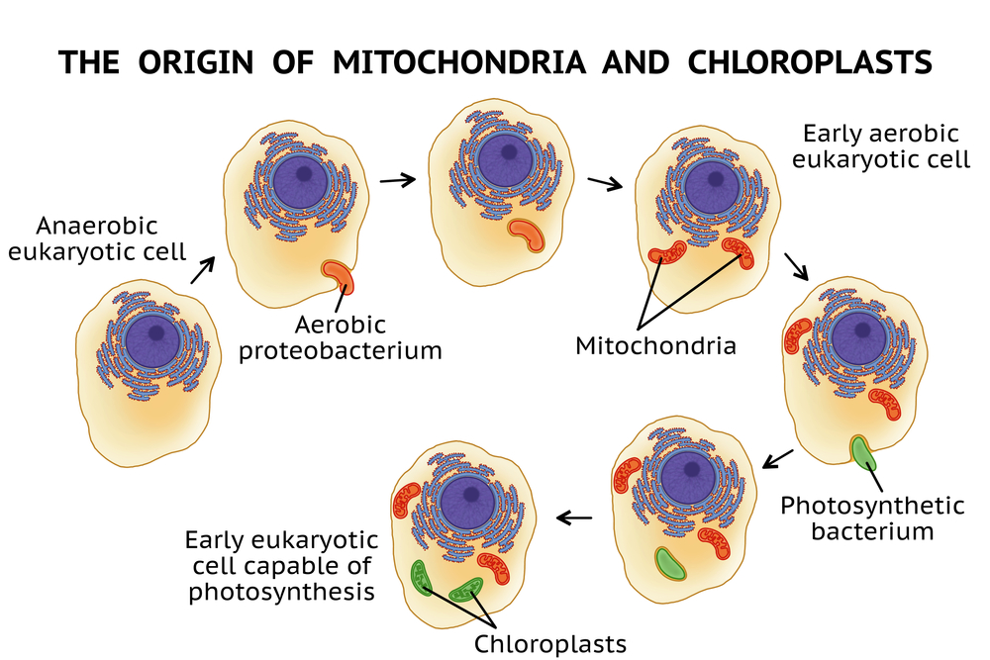
The Evolution of Neurons
Eukaryotes: Bigger, More Complex Cells
Endosymbiosis = “cells inside cells”
Engulfed bacteria → mitochondria
Advantages: more energy, more complexity
Notes:
One of the key innovations during this period was the rise of eukaryotes —
cells that are much larger and more complex than the bacteria and archaea that came before them.
This happened through endosymbiosis.
Some larger cells engulfed smaller oxygen-using bacteria, and instead of digesting them, the partnership stuck. Those smaller bacteria became mitochondria — the powerhouses of the cell.
It’s important to separate two ideas here:
We already talked about aerobic respiration — the chemical process of using oxygen as the final electron acceptor. That gave any cell that could do it a big ATP boost.
What we’re talking about here is the next step: some cells didn’t just rely on their own respiration.
they outsourced it to bacteria that were already really good at it.
Those bacteria set up shop inside the host, becoming mitochondria.
Why was this so powerful? Because mitochondria could generate ATP far more efficiently than the host cell could alone: maybe 30 ATP from a glucose molecule instead of just a couple.
That efficiency meant eukaryotes had an enormous energy surplus.
With that surplus, they could grow larger, evolve internal structures like nuclei and organelles, and eventually support very energy-hungry processes — including neurons.

Slide 7
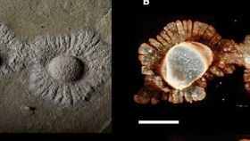
The Evolution of Neurons
Multicellularity: Size and Specialization
Bigger is better (avoid predators, catch prey)
Specialization = division of labor
Cells → tissues → organs
Notes:
With eukaryotes as a foundation, another leap happened: multicellularity.
Why go multicellular?
Size advantage: Being bigger makes it harder to be eaten and easier to eat others.
Specialization: Groups of cells could divide labor — some for movement, some for digestion, some for sensing.
Over time, these groups became tissues and organs.
Multicellularity opened up vast new possibilities for life’s design.
But it also created new coordination problems:
how do cells communicate with each other to act as one organism?
That’s the puzzle that eventually led to neurons.

Slide 8
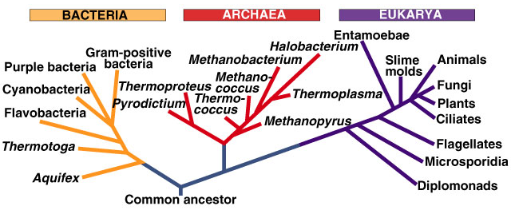
The Evolution of Neurons
Three Strategies of Complex Life
Plants: photosynthesis + chloroplasts
Fungi: decompose, absorb (no neurons)
Animals: active hunting (need neurons)
Notes:
Once eukaryotes took hold, life diversified into three major strategies for complex multicellular organisms.
Plants: Some eukaryotes gained chloroplasts through another endosymbiosis event.
They engulfed photosynthetic bacteria — cyanobacteria — and kept them.
Chloroplasts let plants capture sunlight directly and make their own food.
Fungi: Another lineage became decomposers.
Fungi absorb nutrients from dead or decaying matter.
They don’t move to hunt; instead, they grow into food sources and break them down with enzymes.
Animals: A third lineage became active hunters.
They couldn’t make their own food and they couldn’t just wait for it to rot.
They needed to chase, capture, and digest living prey.
This is the key difference: plants and fungi didn’t need neurons.
They could thrive without fast, coordinated movement.
But animals — predators and prey — did.
For animals, speed and coordination were survival, and that’s why neurons evolved.

Slide 9

The Evolution of Neurons
Why Animals Benefited from Neurons
Plants: no need to chase
Fungi: no need to move
Animals: speed = survival
Sense → Decide → Act
Notes:
Plants and fungi are successful without neurons because their lifestyles don’t require fast action.
Plants stay put and make their own food with sunlight.
Fungi grow into their food and decompose it.
Neither needs rapid sensing or movement.
But animals had a completely different challenge.
Hunting prey — or escaping from being eaten — required speed and coordination.
It wasn’t enough just to grow bigger or stronger. Animals needed a system that could:
Sense changes in the environment,
Decide what to do, and
Act quickly, often in fractions of a second.
That’s why neurons evolved.
Neurons gave animals the ability to rapidly transmit information across their bodies, coordinate muscles, and respond faster than any chemical signal system could.

Slide 10
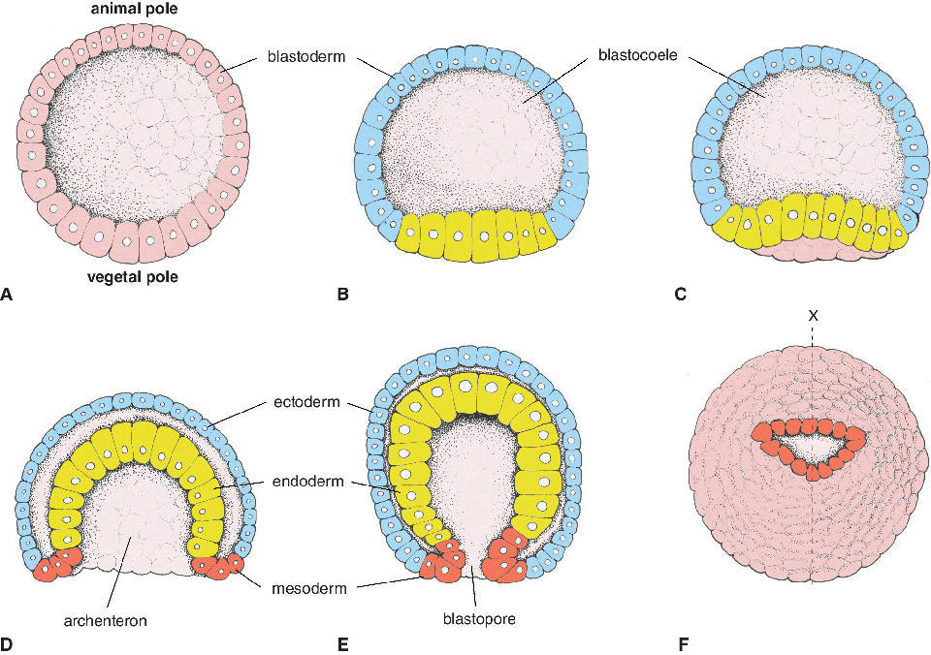
The Evolution of Neurons
Gastrulation & the Animal Template
Gastrulation: early animal development creating a cavity for digestion
Three key tissues emerge:
Gut (stomach)
Muscles
Neurons
Notes:
One of the most fascinating things about animals is how their body plan develops.
Early in embryonic development, there’s a process called gastrulation,
where the embryo folds in on itself and creates different layers of tissue.
Out of that process come three key ingredients that define animals:
A gut for digesting food,
Muscles for moving the body,
And neurons for coordinating those muscles.
These three evolved together, because they depend on one another.
Muscles are useless without something to control them.
A gut is useless without a way to move toward food (or move food toward it).
And neurons wouldn’t be needed if there weren’t muscles and a gut to coordinate.
So neurons weren’t an add-on — they were part of the basic package that made animals, animals.

Slide 11
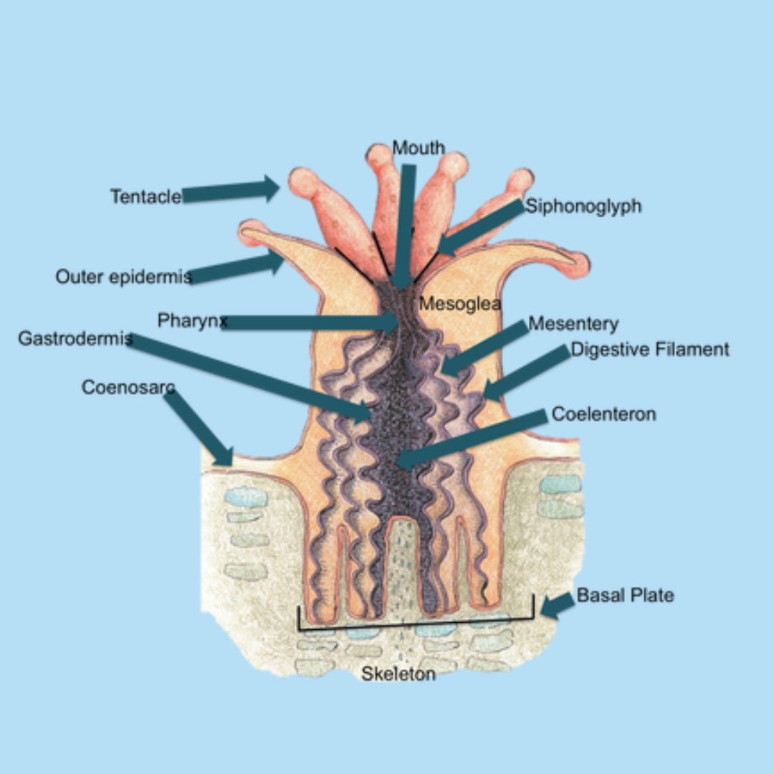
The Evolution of Neurons
Earliest Nervous Systems
Earliest animals: corals, jellyfish
Nerve nets = simple webs of neurons
No brain, but coordinate muscles & feeding
Coral Eating and Digestion
Tentacles sense prey (touch, chemicals)
Neurons trigger stinging cells (cnidocytes)
Muscles contract → tentacle pulls prey in
Gut digests food
Notes:
The earliest animals with neurons were things like corals and jellyfish.
They didn’t have brains — no central control center. Instead, they had what we call a nerve net: a loose web of neurons spread throughout the body.
This was enough for their needs.
The nerve net could coordinate muscles so the jellyfish could pulse through the water,
or respond if something touched their tentacles.
It wasn’t complex decision-making, but it was a major step up from chemical signaling alone.
The nerve net let these animals coordinate a whole body of cells in real time.
Let’s zoom in on a concrete example: how a coral actually uses its neurons to feed.
Corals have tentacles lined with special stinging cells called cnidocytes.
When a tentacle touches prey, or detects the right chemicals, the neurons in that area fire.
That neural signal does two things:
It triggers the cnidocytes to release tiny harpoons loaded with toxins to immobilize the prey.
At the same time, it activates muscle contractions in the tentacle, pulling the prey toward the coral’s mouth.
Once the prey is inside, the gut takes over — enzymes break it down and the nutrients spread through the body.
This whole sequence — sensing, triggering a response, coordinating muscle action — is made possible by neurons. Even in a simple nerve net, neurons already let corals connect sensation to action in a precise and useful way.

Slide 12
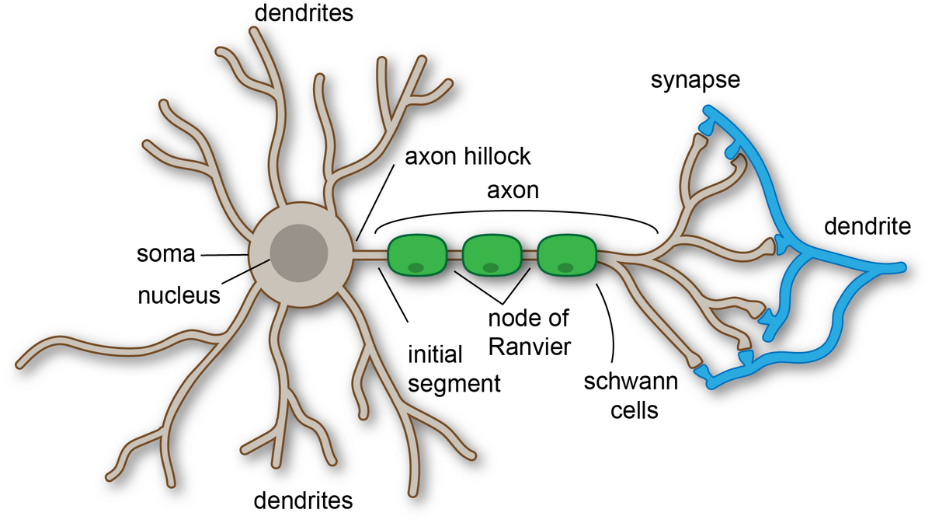
Neuron Structure and Function
What is a Neuron?
Cells already communicated (e.g., chemicals, hormones)
Neurons = faster, longer-distance, more precise
Receive → Process → Send signals
Notes:
Before neurons, cells and even single-celled organisms were already communicating.
Bacteria send out chemical signals to coordinate behavior — for example, when to swarm or form a biofilm.
In multicellular organisms, cells release hormones or other molecules to influence nearby cells.
The problem is that these systems are slow and diffuse.
Chemicals spread gradually, and their effects are hard to control in time or space.
Neurons solved this problem by adding:
Speed — using electrical impulses to carry signals almost instantly,
Distance — sending those signals along long axons,
Precision — releasing neurotransmitters only at specific connection points (synapses).
So neurons didn’t invent communication — they dramatically upgraded it.
They turned a slow, broadcast system into a fast, targeted messaging system that could coordinate complex, rapid actions.

Slide 13
Neuron Structure and Function
The Parts of a Neuron
Dendrites: receive signals
Soma (cell body): integrates
Axon: sends signal
Synapse: junction to next cell
Notes:
Neurons all share a common architecture, even though they come in many shapes and sizes.
Dendrites are like antennas. They receive input from other neurons or sensory cells.
The soma, or cell body, integrates all those inputs — weighing them together.
The axon carries an electrical impulse over long distances, sometimes stretching several feet in large animals.
At the end, the axon makes contact with other cells at a synapse, where chemical neurotransmitters are released.
The flow is always one-way: receive → integrate → send. This is what allows neurons to form circuits.
Each one is a little decision point, passing information along only if it crosses a certain threshold.

Slide 14
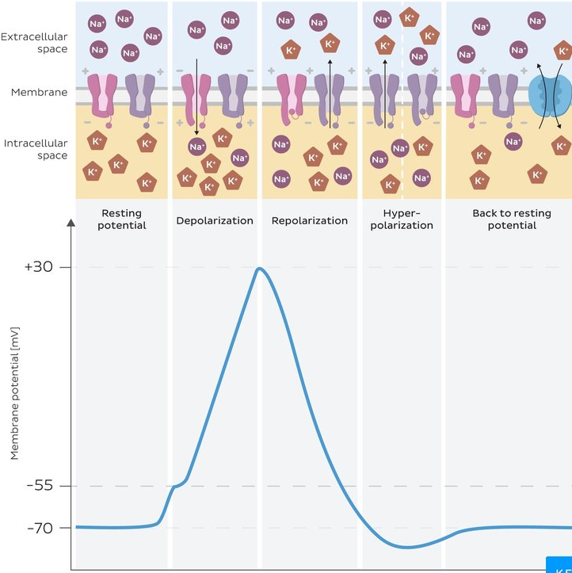
Neuron Structure and Function
Action Potentials
Electrical impulses = spikes
All-or-nothing
Travel long distances quickly
Why Spikes Matter
Fast → millisecond timing
Reliable → signals don’t fade
Coordinate whole body
Foundation for circuits & brains
Notes:
One of the key features that makes neurons so powerful is the action potential — also called a spike.
When a neuron receives enough input, it doesn’t just send a weak or strong signal.
It fires a spike: an all-or-nothing electrical impulse.
If the threshold is crossed, the neuron fires; if not, it stays silent.
These spikes have two big advantages:
They can travel long distances down the axon without fading, like a relay race of electrical charges.
They are fast and reliable, happening in milliseconds.
This is what allows neurons to send signals from one end of a large body to the other almost instantly —
something chemical diffusion alone could never do.

Slide 15
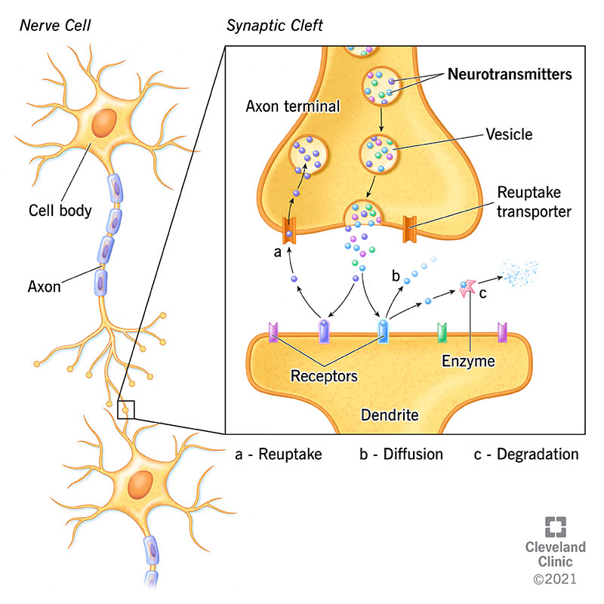
Neuron Structure and Function
Neurotransmitters: Signals Between Neurons
Spikes → release chemicals at synapse
Neurotransmitters cross gap
Bind to receptors on next neuron
Different transmitters = different effects
Glutamate: excitatory.
GABA: inhibitory
Dopamine, serotonin, acetylcholine, norepinephrine — these have more specialized roles, influencing things like motivation, mood, memory, or alertness
Notes:
When a spike reaches the end of an axon, it causes the neuron to release neurotransmitters — chemical messengers — into the synapse.
Those neurotransmitters cross the gap and bind to receptors on the next neuron, changing its likelihood of firing.
Different neurotransmitters can have very different effects:
Glutamate is the main excitatory neurotransmitter in the brain — it makes the next neuron more likely to fire.
GABA is the main inhibitory neurotransmitter — it makes the next neuron less likely to fire.
Dopamine, serotonin, acetylcholine, norepinephrine — these have more specialized roles, influencing things like motivation, mood, memory, or alertness

Slide 16
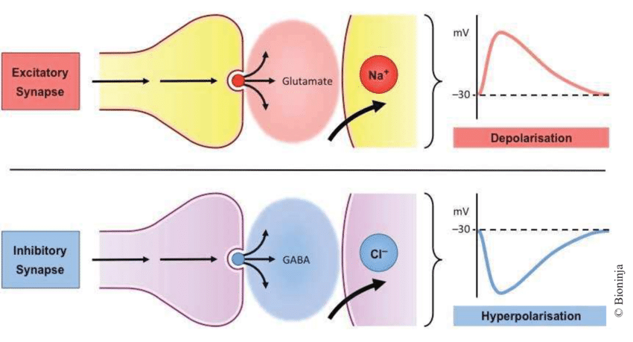
Neuron Structure and Function
Excitatory vs. Inhibitory Neurons
Excitatory: increase chance of downstream (efferent) neurons firing (main example Glutamate).
Inhibitory: decrease chance of downstream (efferent) neurons firing (main example GABA)
Neural Circuits: mixtures of excitatory and inhibitory neurons that allow for specific computations to occur.
Notes:
Not all spikes have the same effect.
Excitatory neurons release neurotransmitters that make the next neuron more likely to fire.
Think of them as ‘go’ signals.
Inhibitory neurons do the opposite — they release neurotransmitters that make the next neuron less likely to fire.
Think of them as ‘stop’ signals.
For example:
Excitatory inputs say ‘move toward food.’
Inhibitory inputs say ‘don’t move if danger is present.’
Real neural circuits always combine both.
It’s the balance of excitation and inhibition that allows neurons to do more than just relay signals —
they can compute complex functions.
Together, the neuron integrates these signals and only fires if the overall balance says it’s worth it.
This is the beginning of how neurons implement logic in the brain.
We talk a lot more about that in the neural circuits module.

Slide 17
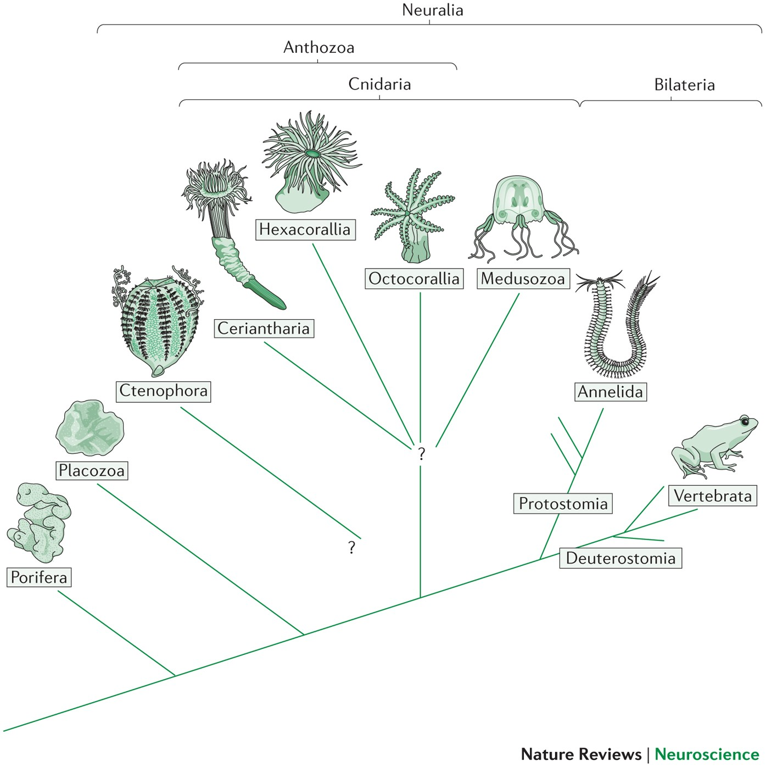
Summarizing the Evolution of Neurons
Today we saw…
Oxygen → new energy → eukaryotes
Multicellularity → specialization
Animals needed speed → neurons evolved
Neurons = spikes, synapses, neurotransmitters
Next time…
Nerve nets are not yet brains
How neurons were organized to steer, choose, decide
The first simple brains
Notes:
Today we saw how oxygen powered a new energy world, leading to eukaryotes, multicellularity, and three major strategies of life.
For animals, speed mattered most — and that drove the invention of neurons.
We also looked at how neurons actually work: spikes, synapses, neurotransmitters, and the balance of excitation and inhibition.
But so far, we’ve only talked about nerve nets.
These can connect sensation to action, but they don’t yet make complex choices.
The next big step was organizing neurons into brains — centers that can integrate information and decide what to do.
Next time, we’ll see how evolution made the leap from nerve nets to the first simple brains.

